Slide 1




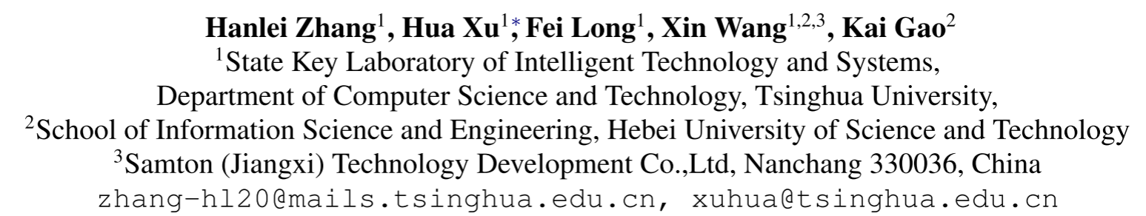



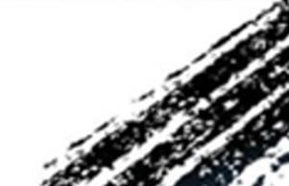

ATAI
Advanced Techniqueof Artificial Intelligence
ATAI
ChongqingUniversity _{AdvancedTechniqueof}
of Technology Artificial Intelligence
Chongqing University of
Technology
Chongqing University ^{ATAI}
_{of Technology} Advanced Techniqueof
Artificial Intelligence
Chongqing University of Technology
Chongqing University of Technology
Unsupervised Multimodal Clustering for Semantics Discovery in Multimodal Utterances
Unsupervised Multimodal Clustering for Semantics Discovery in Multimodal Utterances
Code:https://github.com/thuiar/UMC
—— ACL 2024
Reported by Tingting Zhang
1

Slide 2

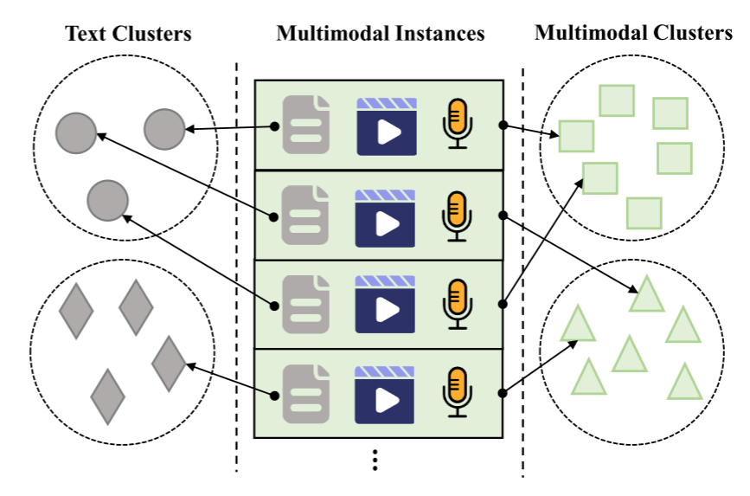
ATAI
AdvancedTechniqueof
Artificial Intelligence
ATAI
ChongqingUniversity _{AdvancedTechniqueof}
of Technology Artificial Intelligence
ChongqingUniversity of Technology
Motivation
there is a lack of multimodal clustering methods for discovering utterance semantics, posing two challenges:
(1) determining how to leverage information from nonverbal modalities to complement the text modality in clustering,
(2) devising ways to fully exploit multimodal unlabeled data to learn clusteringfriendly representations.

Slide 3

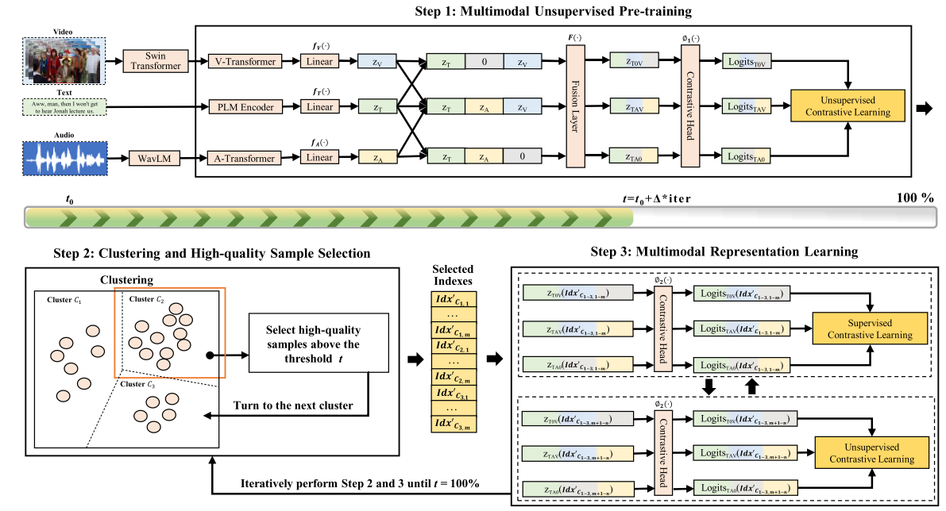
ChongqingUniversity of Technology
ATAI
AdvancedTechniqueof
Artificial Intelligence
ATAI
ChongqingUniversity _{AdvancedTechniqueof}
of Technology Artificial Intelligence
Overview

Slide 4

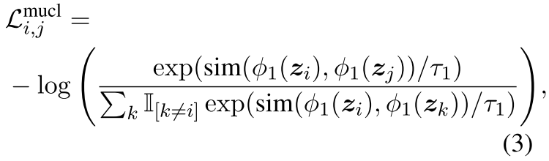

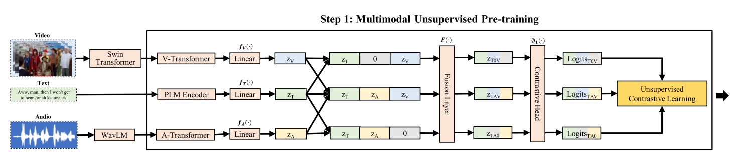
ChongqingUniversity of Technology
ATAI
AdvancedTechniqueof
Artificial Intelligence
ATAI
ChongqingUniversity _{AdvancedTechniqueof}
of Technology Artificial Intelligence
Method
1. Multimodal Representation
2. Multimodal Unsupervised Pre-training

Slide 5
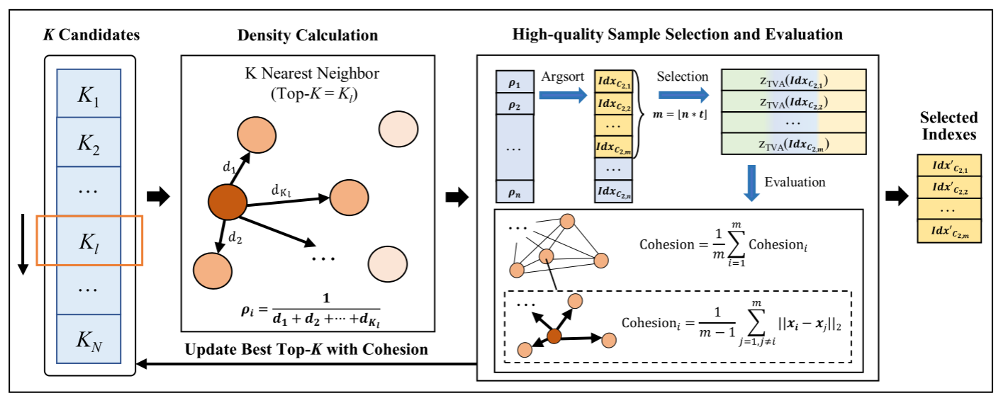
ChongqingUniversity of Technology
ATAI
AdvancedTechniqueof
Artificial Intelligence
ATAI
ChongqingUniversity _{AdvancedTechniqueof}
of Technology Artificial Intelligence
Method
3. Clustering and High-Quality Sample Selection

Slide 6
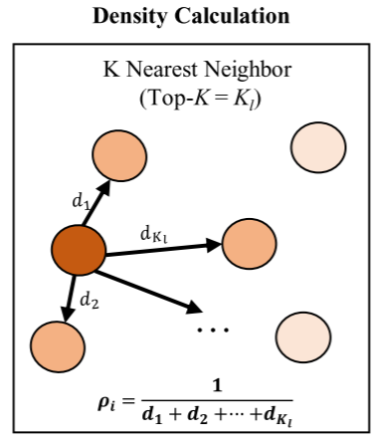
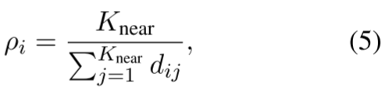

ChongqingUniversity of Technology
ATAI
AdvancedTechniqueof
Artificial Intelligence
ATAI
ChongqingUniversity _{AdvancedTechniqueof}
of Technology Artificial Intelligence
Method
3. Clustering and High-Quality Sample Selection

Slide 7
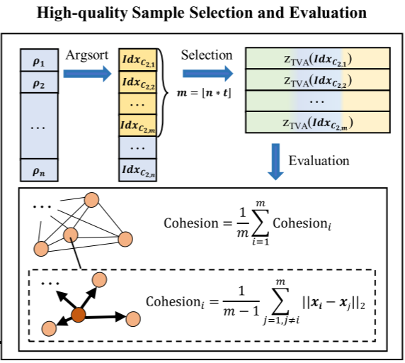
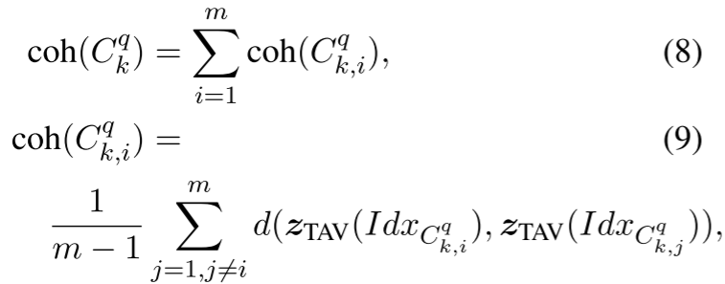

ChongqingUniversity of Technology
ATAI
AdvancedTechniqueof
Artificial Intelligence
ATAI
ChongqingUniversity _{AdvancedTechniqueof}
of Technology Artificial Intelligence
Method
3. Clustering and High-Quality Sample Selection

Slide 8
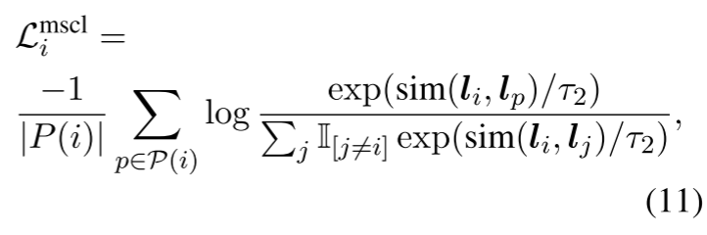
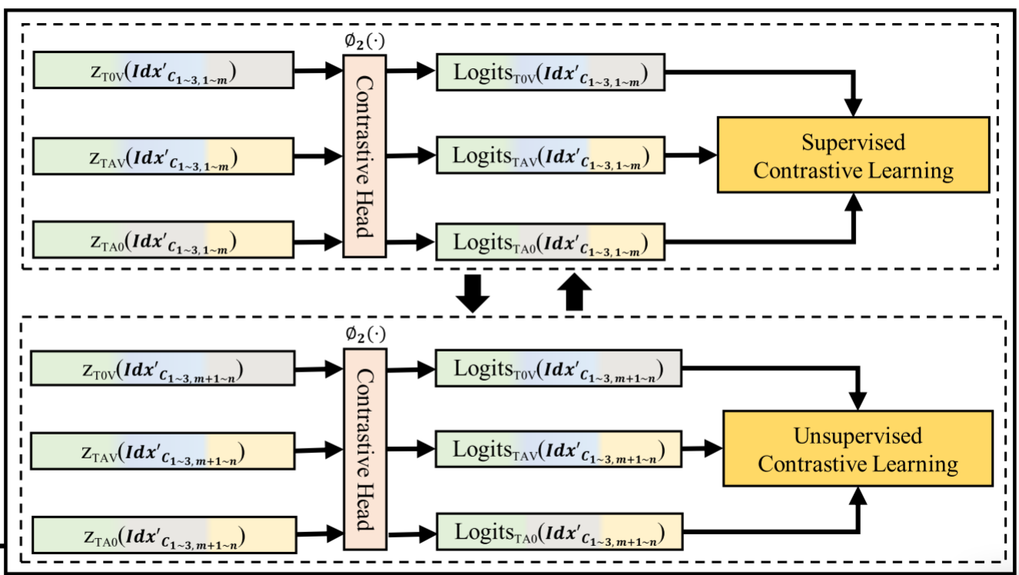
ChongqingUniversity of Technology
ATAI
AdvancedTechniqueof
Artificial Intelligence
ATAI
ChongqingUniversity _{AdvancedTechniqueof}
of Technology Artificial Intelligence
Method
4. Multimodal Representation Learning

Slide 9

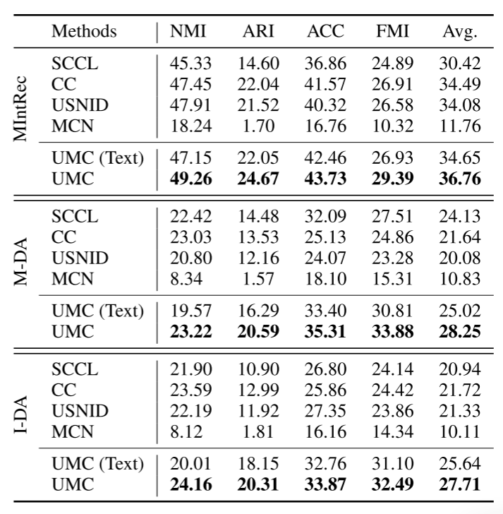
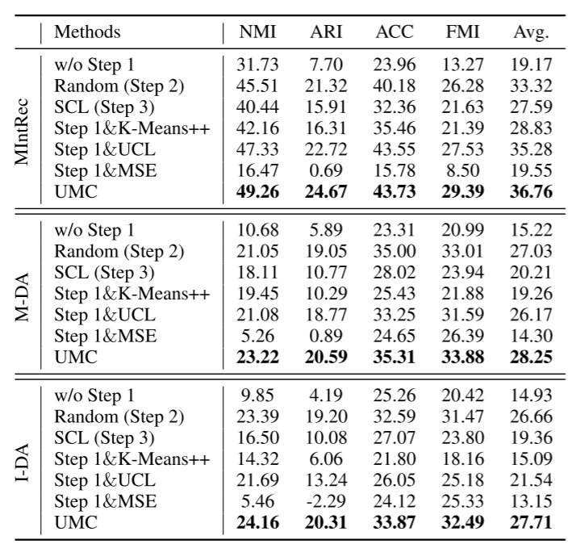
ATAI
AdvancedTechniqueof
Artificial Intelligence
ATAI
ChongqingUniversity _{AdvancedTechniqueof}
of Technology Artificial Intelligence
ChongqingUniversity of Technology
Experiments

Slide 10
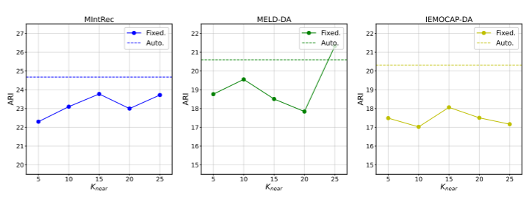
ATAI
AdvancedTechniqueof
Artificial Intelligence
ATAI
ChongqingUniversity _{AdvancedTechniqueof}
of Technology Artificial Intelligence
ChongqingUniversity of Technology
Experiments

Slide 11
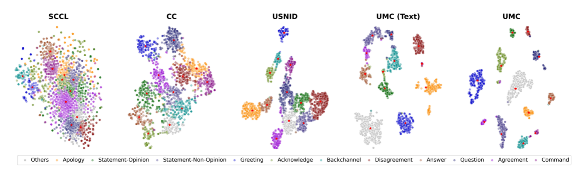
ATAI
AdvancedTechniqueof
Artificial Intelligence
ATAI
ChongqingUniversity _{AdvancedTechniqueof}
of Technology Artificial Intelligence
ChongqingUniversity of Technology
Experiments

Slide 12


ChongqingUniversity of Technology
ATAI
AdvancedTechniqueof
Artificial Intelligence
ATAI
ChongqingUniversity _{AdvancedTechniqueof}
of Technology Artificial Intelligence
Thanks!

